Slide 1
2-4-1 OpenVPN

Slide 2
You Want a VPN
But a SIMPLE One
and IPsec is Not Simple
2-4-1 OpenVPN
Creative Commons: Attribution-NonCommercial-ShareAlike

Slide 3
OpenVPN
Open Protocol
Open Source Tools
Not Known to be Pwned by the NSA, GCHQ, …
2-4-1 OpenVPN
Creative Commons: Attribution-NonCommercial-ShareAlike

Slide 4
Easy to Install
Free Server(s)
Easy to Install
Free Clients
They Interoperate!
2-4-1 OpenVPN
Creative Commons: Attribution-NonCommercial-ShareAlike

Slide 5
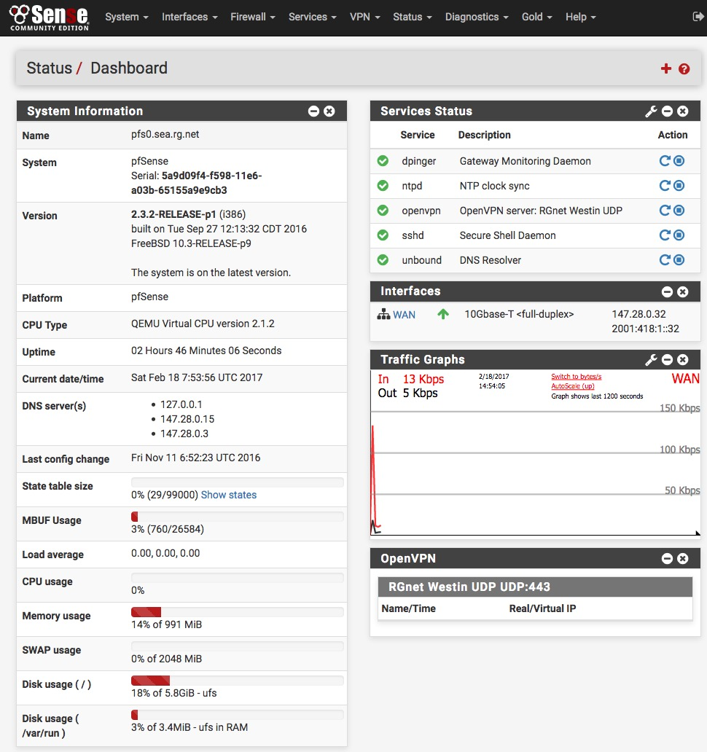
OpenVPN Server
pfSense
2-4-1 OpenVPN
Creative Commons: Attribution-NonCommercial-ShareAlike

Slide 6
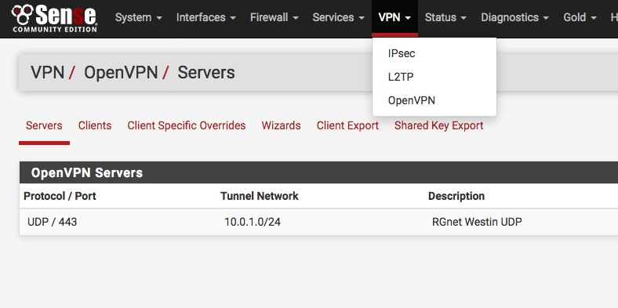
VPN Server
2-4-1 OpenVPN
Creative Commons: Attribution-NonCommercial-ShareAlike

Slide 7
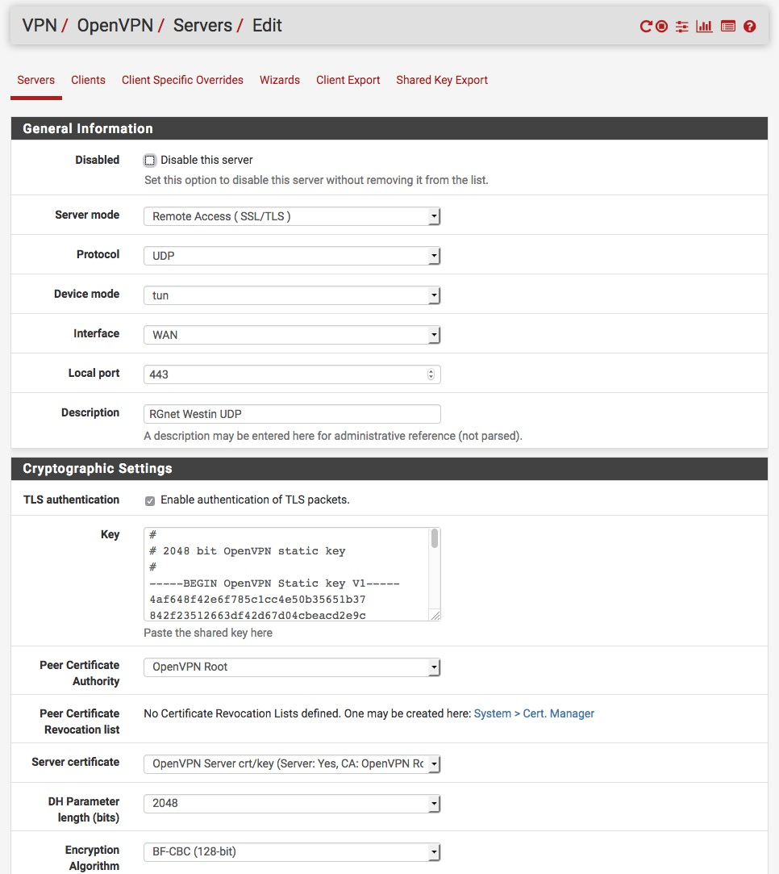
Configuration!
2-4-1 OpenVPN
Creative Commons: Attribution-NonCommercial-ShareAlike

Slide 8
Select a Client
http://psg.com/1.html
2-4-1 OpenVPN
Creative Commons: Attribution-NonCommercial-ShareAlike

Slide 9
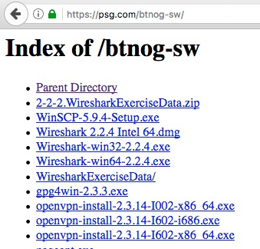
Or Get One Here
(64-bit), Windows XP
(32-bit), Windows Vista and later
(64-bit), Windows Vista and later
2-4-1 OpenVPN
Creative Commons: Attribution-NonCommercial-ShareAlike

Slide 10
OpenVPN Clients for Various Platforms
OpenVPN Community Client - Binaries for Windows, Source for other platforms.
OpenVPN For Android - Recommended client for Android
FEAT VPN For Android - For older versions of Android
OpenVPN Connect: Android (Google Play) or iOS (App Store) - Recommended client for iOS
Viscosity - Recommended GUI client for Mac OSX $$
Tunnelblick - Free client for OSX
2-4-1 OpenVPN
Creative Commons: Attribution-NonCommercial-ShareAlike

Slide 11

Download Installer
2-4-1 OpenVPN
Creative Commons: Attribution-NonCommercial-ShareAlike

Slide 12
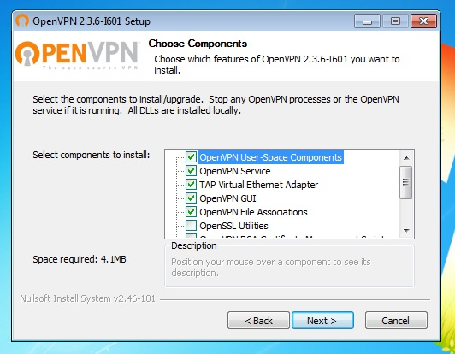
Run Installer
2-4-1 OpenVPN
Creative Commons: Attribution-NonCommercial-ShareAlike

Slide 13
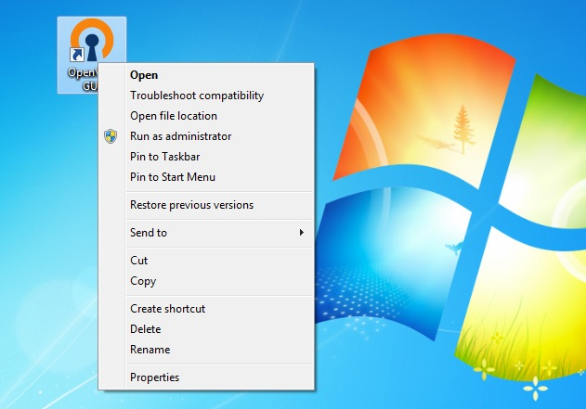
Set RunAsAdmin
So Client Can Install Routes
2-4-1 OpenVPN
Creative Commons: Attribution-NonCommercial-ShareAlike

Slide 14
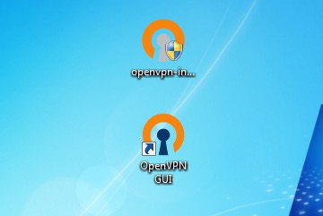
You Can Delete Installer
Open GUI (invisible)
2-4-1 OpenVPN
Creative Commons: Attribution-NonCommercial-ShareAlike

Slide 15
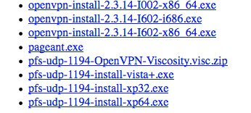
Get Credentials
MacOS
Windows Vista and later
(32-bit), Windows XP
(64-bit), Windows XP
2-4-1 OpenVPN
Creative Commons: Attribution-NonCommercial-ShareAlike

Slide 16
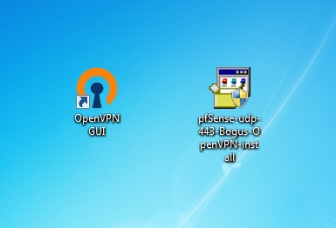
Execute Credential EXE
2-4-1 OpenVPN
Creative Commons: Attribution-NonCommercial-ShareAlike

Slide 17
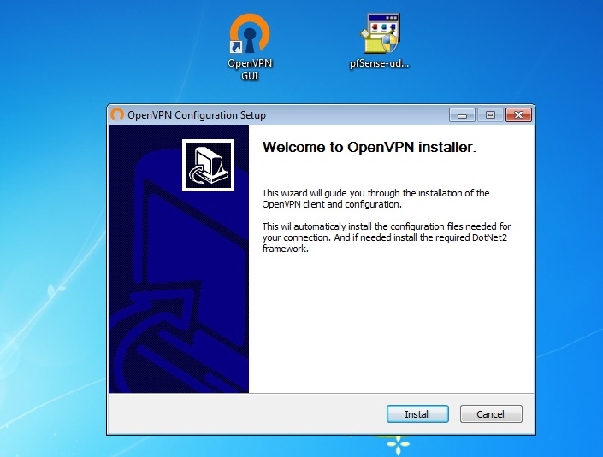
Install Credentials
2-4-1 OpenVPN
Creative Commons: Attribution-NonCommercial-ShareAlike

Slide 18
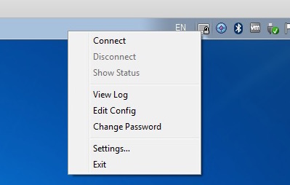
Connect
2-4-1 OpenVPN
Creative Commons: Attribution-NonCommercial-ShareAlike

Slide 19
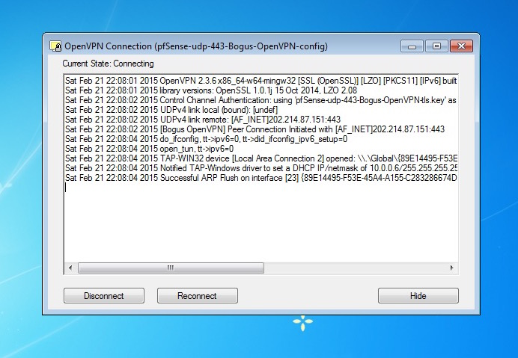
Connecting
2-4-1 OpenVPN
Creative Commons: Attribution-NonCommercial-ShareAlike

Slide 20
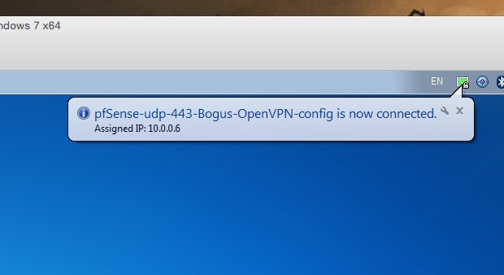
You’re Connected!
2-4-1 OpenVPN
Creative Commons: Attribution-NonCommercial-ShareAlike

Slide 21
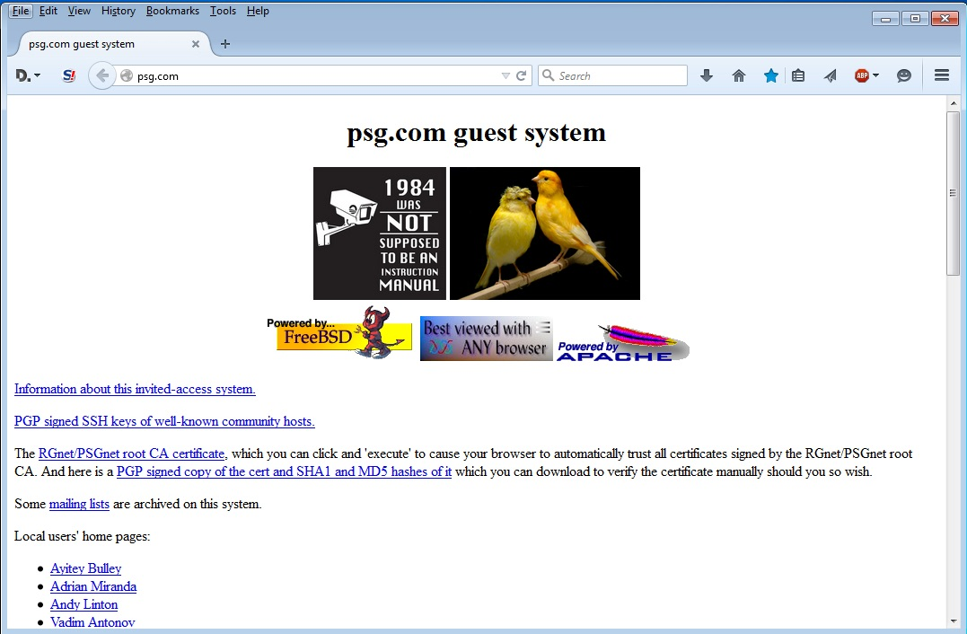
Try It – Browse
2-4-1 OpenVPN
Creative Commons: Attribution-NonCommercial-ShareAlike

Slide 22
But How Do You
Know It Works?
Is your traffic encrypted?
Use Wireshark!
Where are you?
traceroute psg.com

Slide 23
Without VPN
ryuu.psg.com:/Users/presenter> traceroute psg.com
traceroute to psg.com (147.28.0.62), 64 hops max, 52 byte packets
1 252.151.dhcp.conference.apricot.net (220.247.151.252) 1343.693 ms 1.342 ms 1.108 ms
2 ci53.23-213.netnam.vn (101.53.23.213) 1.390 ms 1.635 ms 1.551 ms
3 172.20.1.2 (172.20.1.2) 1.625 ms 1.587 ms 1.734 ms
4 1-43_2313.r0.409.mi.hk.iptp.net (103.6.131.174) 66.879 ms 51.207 ms 53.409 ms
5 63-218-211-141.static.pccwglobal.net (63.218.211.141) 266.357 ms 207.636 ms 224.782 ms
6 hundredge0-5-0-0.br02.hkg08.pccwbtn.net (63.223.29.198) 54.618 ms 52.381 ms 51.697 ms
7 63-218-205-86.static.pccwglobal.net (63.218.205.86) 52.479 ms 56.466 ms 52.707 ms
8 ae-12.r24.osakjp02.jp.bb.gin.ntt.net (129.250.2.223) 104.518 ms * 105.996 ms
9 ae-4.r20.sttlwa01.us.bb.gin.ntt.net (129.250.2.39) 180.351 ms 182.174 ms
ae-12.r24.osakjp02.jp.bb.gin.ntt.net (129.250.2.223) 104.324 ms
10 ae-4.r20.sttlwa01.us.bb.gin.ntt.net (129.250.2.39) 182.066 ms
ae-29.r05.sttlwa01.us.bb.gin.ntt.net (129.250.2.89) 211.749 ms
ae-4.r20.sttlwa01.us.bb.gin.ntt.net (129.250.2.39) 184.729 ms
11 ae-29.r05.sttlwa01.us.bb.gin.ntt.net (129.250.2.89) 209.519 ms
ae-28.r05.sttlwa01.us.bb.gin.ntt.net (129.250.2.45) 208.254 ms
ae-29.r05.sttlwa01.us.bb.gin.ntt.net (129.250.2.89) 209.292 ms
12 psg.com (147.28.0.62) 216.953 213.717 218.281
2-4-1 OpenVPN
Creative Commons: Attribution-NonCommercial-ShareAlike

Slide 24
With VPN
ryuu.psg.com:/Users/presenter> traceroute psg.com
traceroute to psg.com (147.28.0.62), 64 hops max, 52 byte packets
1 10.0.1.1 (10.0.1.1) 1773.479 ms 103.112 ms 103.036 ms
2 202.214.87.130 (202.214.87.130) 104.809 ms 104.118 ms 103.963 ms
3 210.138.9.201 (210.138.9.201) 109.969 ms 105.199 ms 103.556 ms
4 tky009ipgw11.iij.net (58.138.112.53) 104.284 ms 106.700 ms 104.392 ms
5 tky009bb01.iij.net (58.138.112.157) 104.760 ms 104.872 ms 105.114 ms
6 sea001bb00.iij.net (58.138.88.230) 236.930 ms 239.763 ms *
7 six (206.81.80.23) 237.853 ms 237.146 ms 237.147 ms
8 147.28.0.62 (147.28.0.62) 216.686 ms 211.543 ms 210.681 ms
2-4-1 OpenVPN
Creative Commons: Attribution-NonCommercial-ShareAlike

